Slide 1


Computer
Lecture 1
Dr. Nada Abdullah Rasheed
Assist prof. / Computer Science

Slide 2
Syllabus Content
Subject | Lec. No.
Definition of Computer | 3
History of Computers | 5

Slide 3
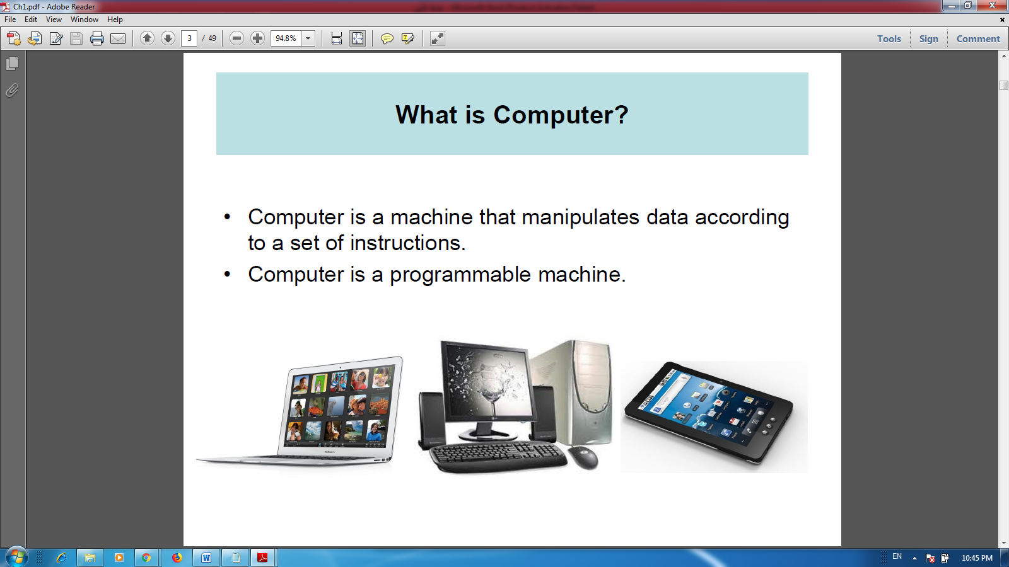
Definition of Computer:
The computer is a machine that manipulates data according to a set of instructions.
The computer is a programmable machine.
The computer is any device which aids humans in performing various kinds of computations or calculations.

Slide 4
Central processing unit (CPU): The heart of the computer, this is the component that actually executes instructions organized in programs ("software") which tell the computer what to do.
Memory (fast, expensive, short-term memory): Enables a computer to store, at least temporarily, data, programs, and intermediate results.
Storage device (slower, cheaper, long-term memory): Allows a computer to permanently retain large amounts of data and programs between jobs. Common mass storage devices include disk drives and tape drives.
Input device: Usually a keyboard and mouse, the input device is the conduit through which data and instructions enter a computer.
Output device: A display screen, printer, or other device that lets you see what the computer has accomplished.

Slide 5
History of Computers:
Earliest Computer
Originally calculations were computed by humans, whose job title was computers.
These human computers were typically engaged in the calculation of a mathematical expression.
The calculations of this period were specialized and expensive, requiring years of training in mathematics.
The first use of the word "computer" was recorded in 1613, referring to a person who carried out calculations, or computations, and the word continued to be used in that sense until the middle of the 20th century.

Slide 6
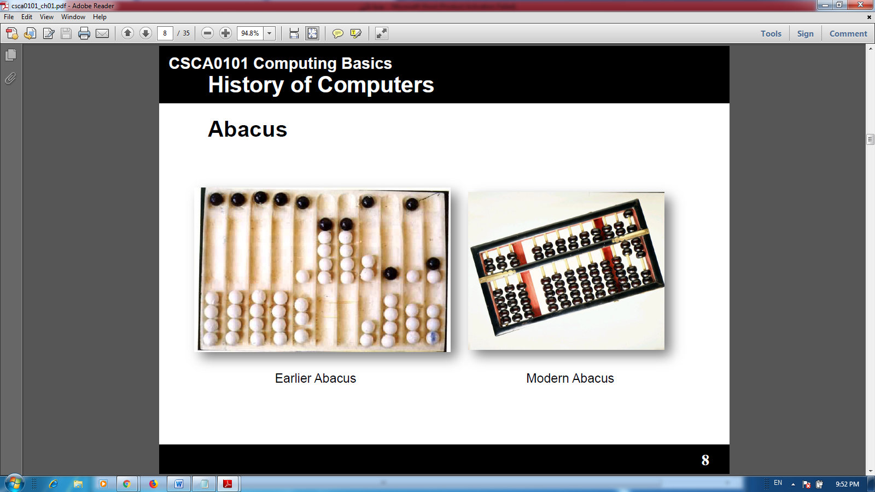
Abacus
An abacus is a mechanical device used to aid an individual in performing mathematical calculations.
The abacus was invented in Babylonia in 2400 B.C.
The abacus in the form we are most familiar with was first used in China in around 500 B.C.
It used to perform basic arithmetic operations.

Slide 7
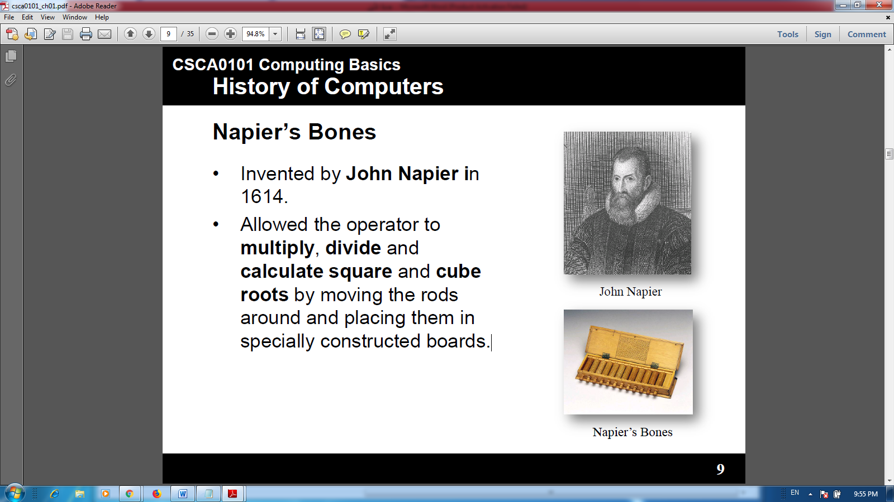
Napier’s Bones
• Invented by John Napier in 1614.
• Allowed the operator to multiply, divide and calculate square and cube roots by moving the rods around and placing them in specially constructed boards.

Slide 8
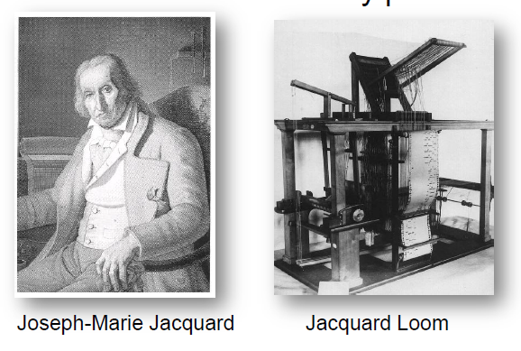
Jacquard Loom
•The Jacquard loomis a mechanical loom, invented by Joseph-Marie Jacquard in 1881.
•It an automatic loom controlled by punched cards.

Slide 9
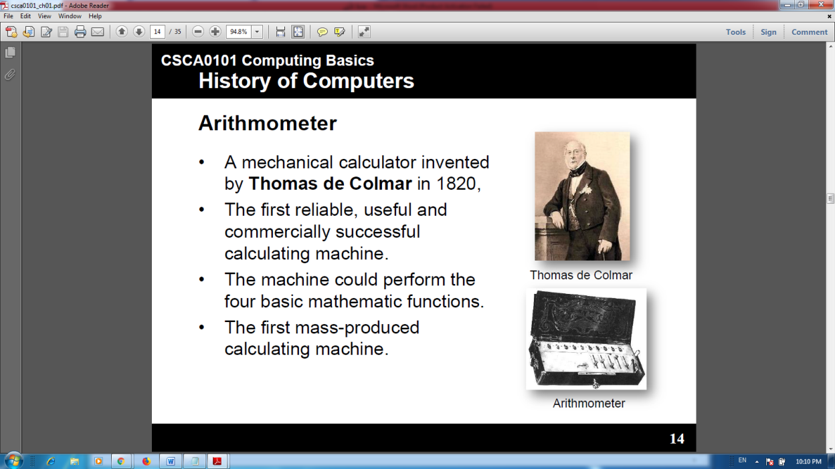
Arithmometer
•A mechanical calculator invented by Thomas de Colmarin 1820,
•The first reliable, useful and commercially successful calculating machine.
•The machine could perform the four basic mathematic functions.
•The first mass-produced calculating machine.

Slide 10
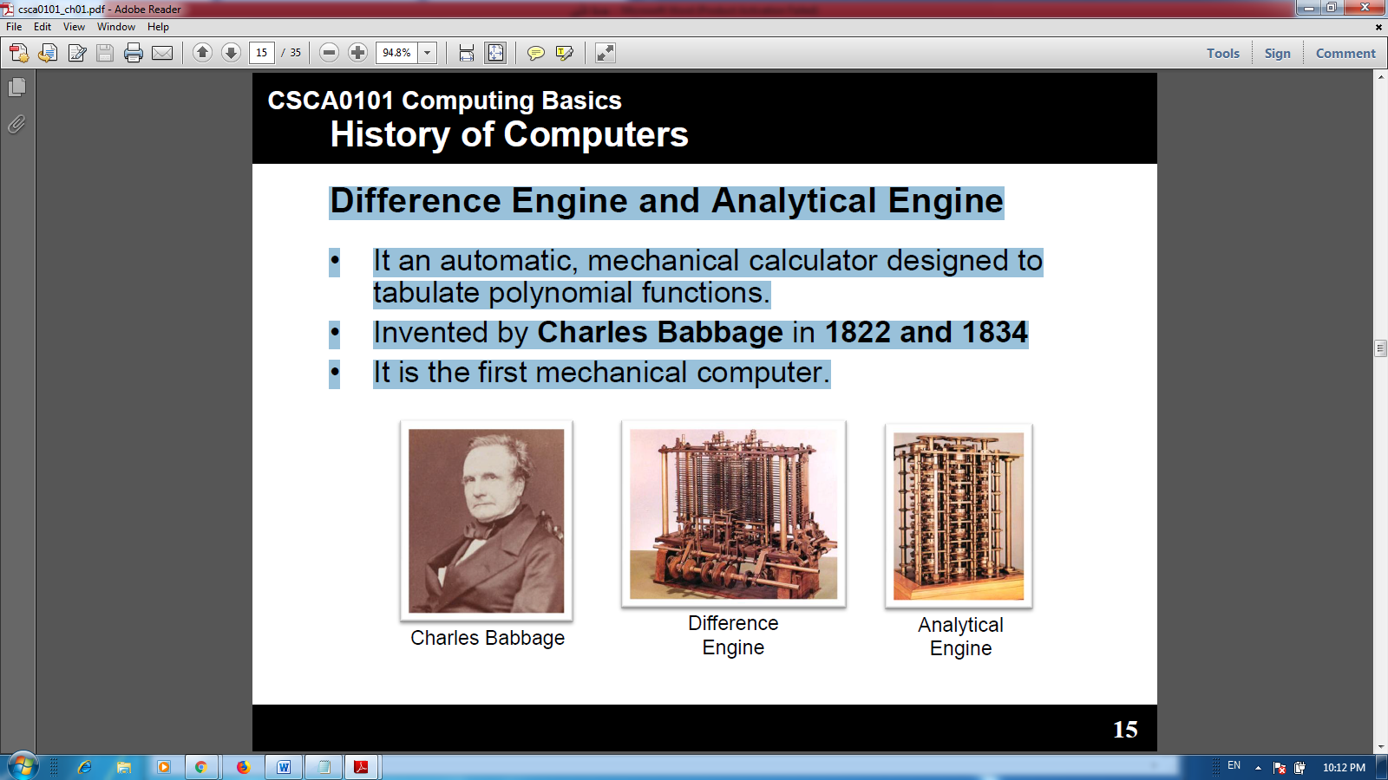
Difference Engine and Analytical Engine
•It an automatic, mechanical calculator designed to tabulate polynomial functions.
•Invented by Charles Babbage in1822 and 1834
•It is the first mechanical computer.

Slide 11
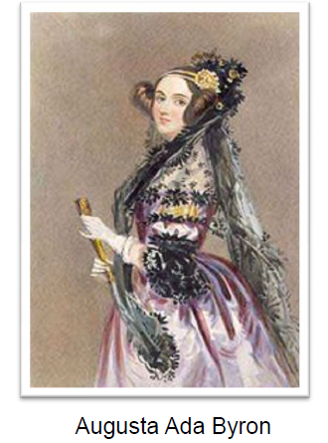
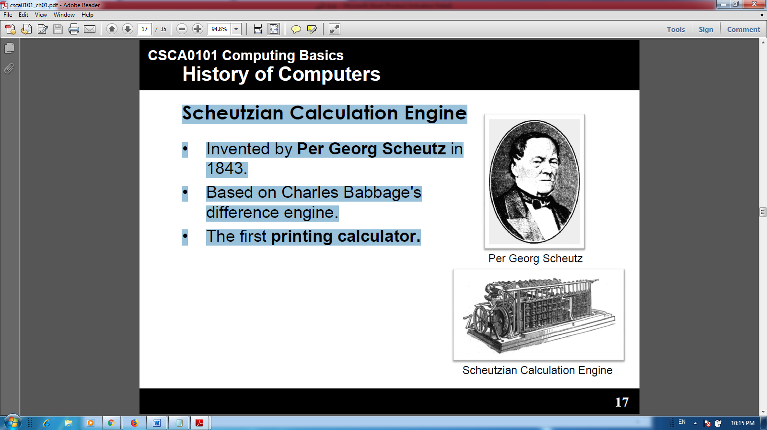
First Computer Programmer
•In 1840, Augusta Ada Byronsuggests to Babbage that she uses the binary system.
•She writes programs for the Analytical Engine.
Scheutzian Calculation Engine
•Invented by Per Georg Scheutz in 1843.
•Based on Charles Babbage's difference engine.
•The first printing calculator.

Slide 12
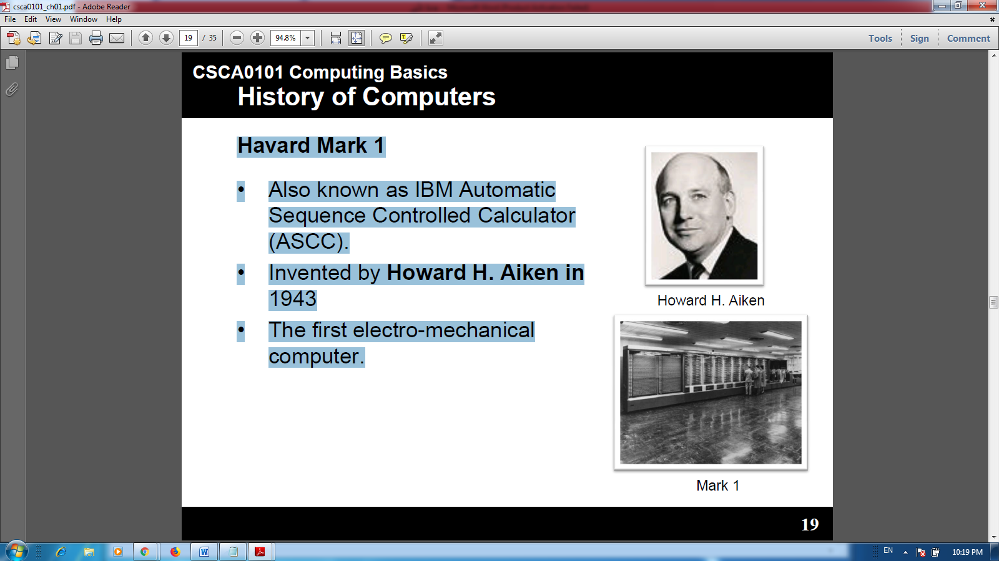
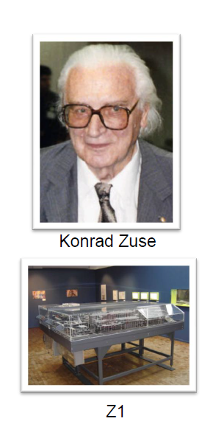
Havard Mark 1
•Also known as IBM Automatic Sequence Controlled Calculator (ASCC).
•Invented by Howard H. Aikenin 1943
•The first electro-mechanical computer.
Z1
•The first programmable computer.
•Created by Konrad Zusein Germany from 1936 to 1938.
•To program the Z1 required that the user insert punch tape into a punch tape reader and all output was also generated through punch tape.

Slide 13
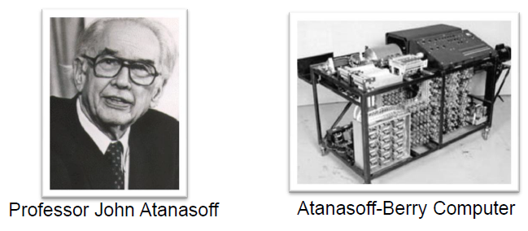
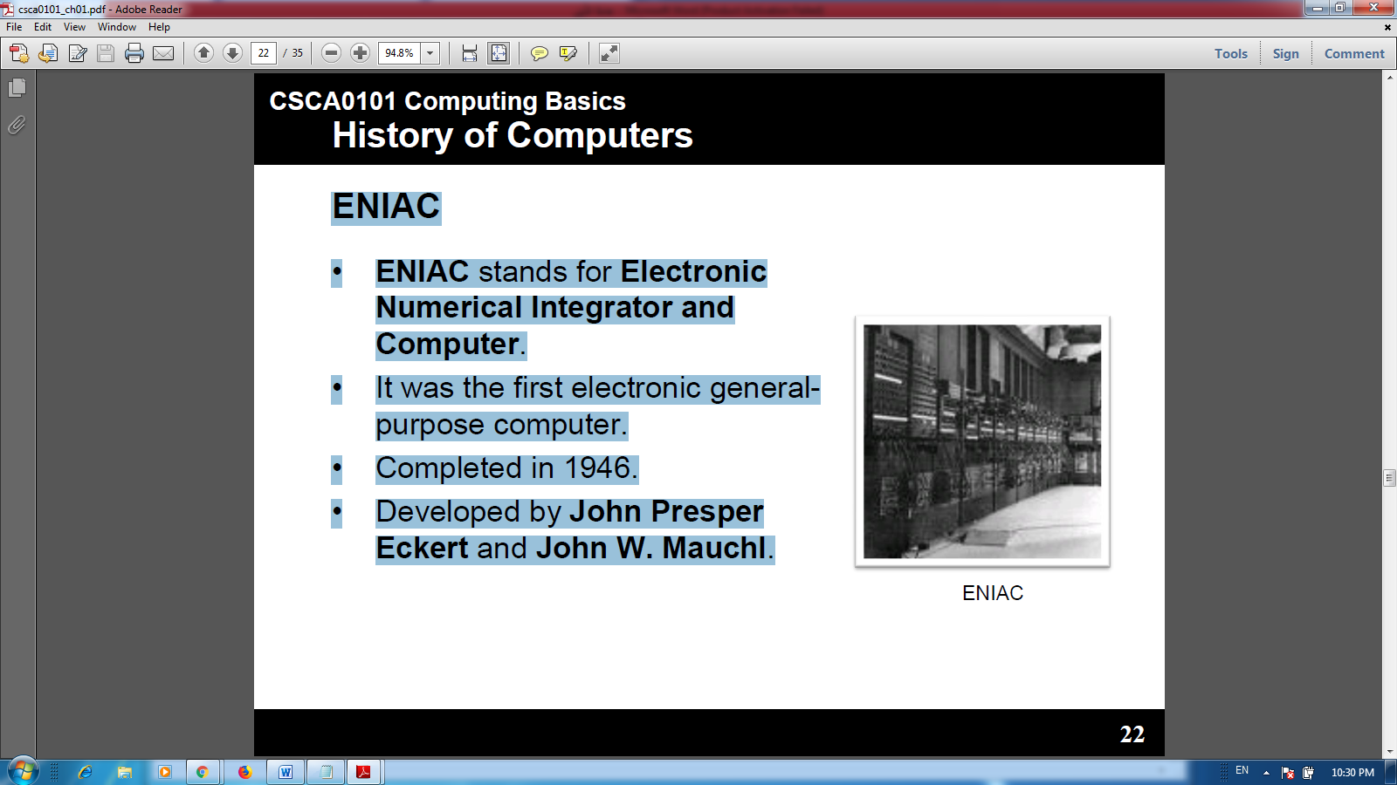
Atanasoff-Berry Computer (ABC)
•It was the first electronic digital computing device.
•Invented by Professor John Atanasoffand graduate student Clifford Berry at Iowa State University between 1939 and 1942.
ENIAC
•ENIAC stands for Electronic Numerical Integrator and Computer.
•It was the first electronic general-purpose computer.
•Completed in 1946.
•Developed by John Presper Eckertand John W. Mauchl.

